Slide 1
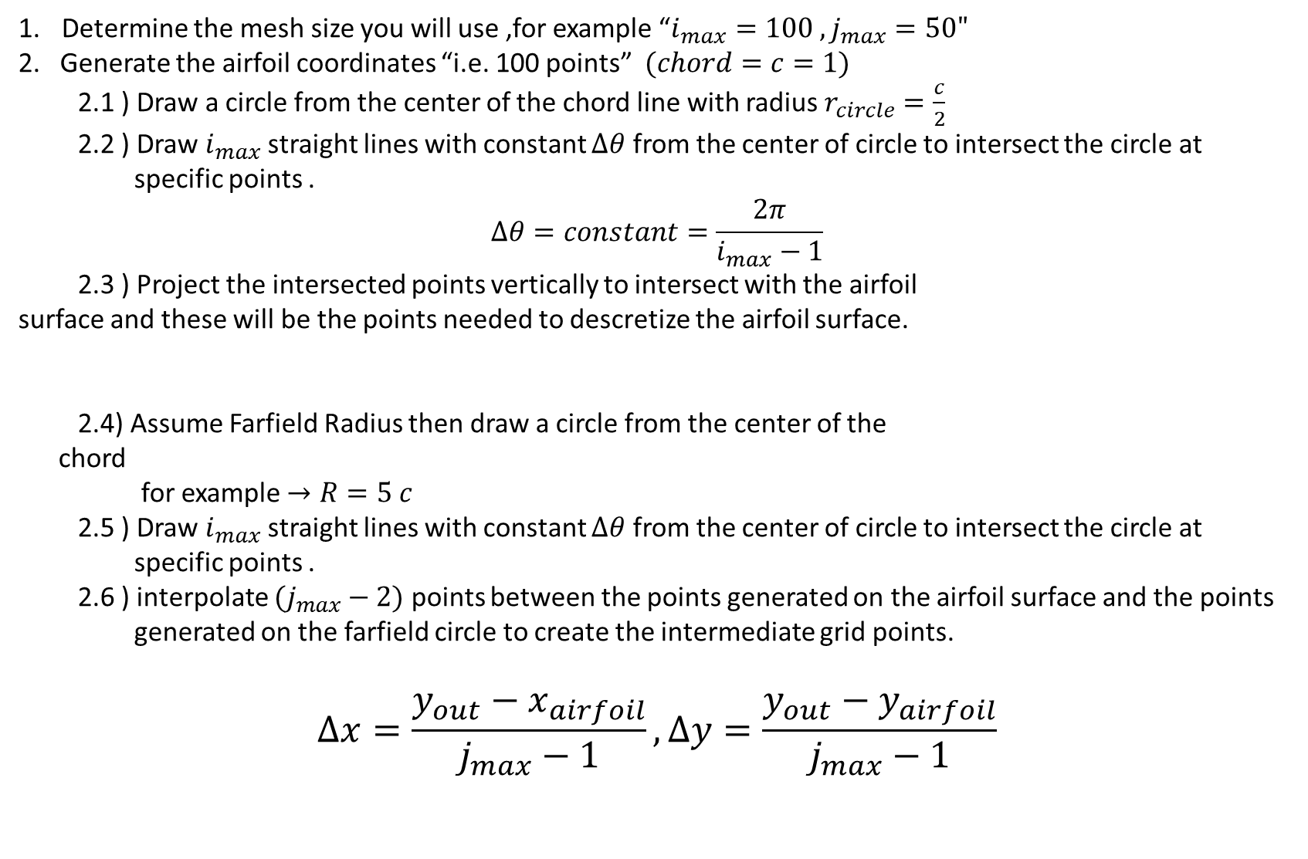
Flow Over an Airfoil Using O-grid
Determine the mesh size you will use ,for example “$i_{max}=100 ,j_{max}=50"$
2. Generate the airfoil coordinates “i.e. 100 points” $(chord=c=1)$
2.1 ) Draw a circle from the center of the chord line with radius $r_{circle}=\frac{c}{2}$
2.2 ) Draw $i_{max}$straight lines with constant $Δθ$ from the center of circle to intersect the circle at specific points .
$$Δθ=constant=\frac{2π}{i_{max}−1}$$
2.3 ) Project the intersected points vertically to intersect with the airfoil
surface and these will be the points needed to descretize the airfoil surface.
2.4) Assume Farfield Radius then draw a circle from the center of the
chord
for example $→R=5 c$
2.5 ) Draw $i_{max}$straight lines with constant $Δθ$ from the center of circle to intersect the circle at specific points .
2.6 ) interpolate $(j_{max}−2)$ points between the points generated on the airfoil surface and the points generated on the farfield circle to create the intermediate grid points.
$$Δx=\frac{{y_{out}−x}_{airfoil}}{j_{max}−1},Δy=\frac{{y_{out}−y}_{airfoil}}{j_{max}−1}$$

Slide 2
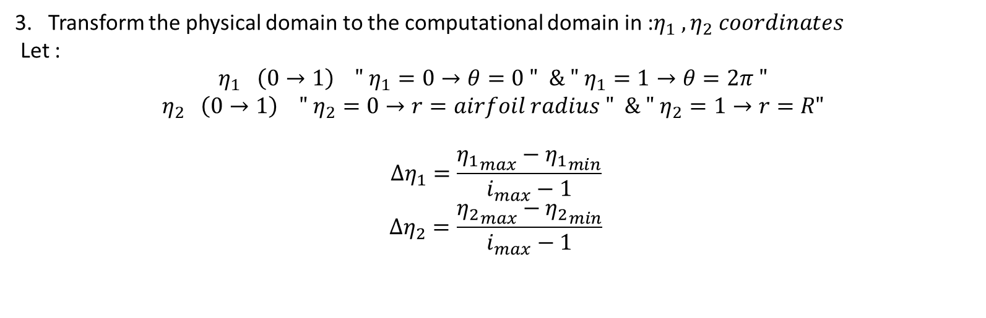
Flow Over an Airfoil Using O-grid
3. Transform the physical domain to the computational domain in :$η_{1} ,η_{2} coordinates$
Let :
$$η_{1} \left(0→1\right) " η_{1}=0→θ=0 " \& " η_{1}=1→θ=2π "$$
$$η_{2} \left(0→1\right) " η_{2}=0→r=airfoil radius " \& " η_{2}=1→r=R"$$
$$Δη_{1}=\frac{{η_{1}}_{max}−{η_{1}}_{min}}{i_{max}−1}$$
$$Δη_{2}=\frac{{η_{2}}_{max}−{η_{2}}_{min}}{i_{max}−1}$$

Slide 3
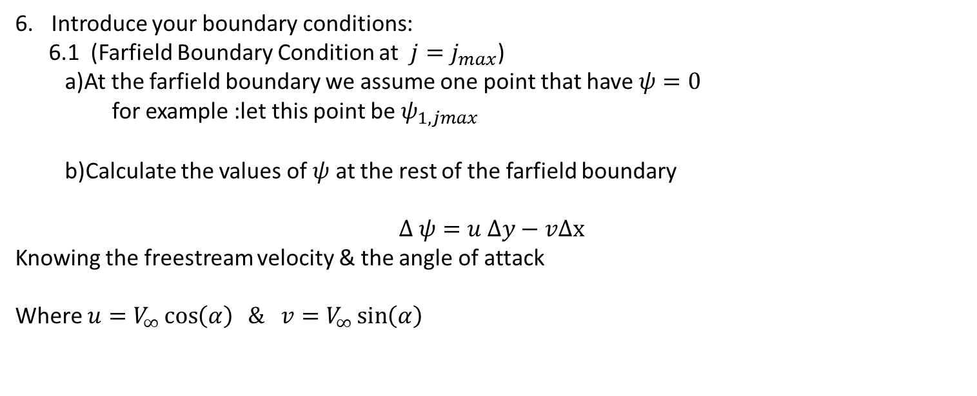

Flow Over an Airfoil Using O-grid
Introduce your boundary conditions:
6.1 (Farfield Boundary Condition at $j=j_{max}$)
a)At the farfield boundary we assume one point that have $ψ=0$
for example :let this point be $ψ_{1,jmax}$
b)Calculate the values of $ψ$ at the rest of the farfield boundary
$$Δ ψ=u Δy−vΔx$$
Knowing the freestream velocity & the angle of attack
Where $u=V_{∞}\cos\left(α\right) \& v=V_{∞}\sin\left(α\right)$
$$ψ=0$$

Slide 4
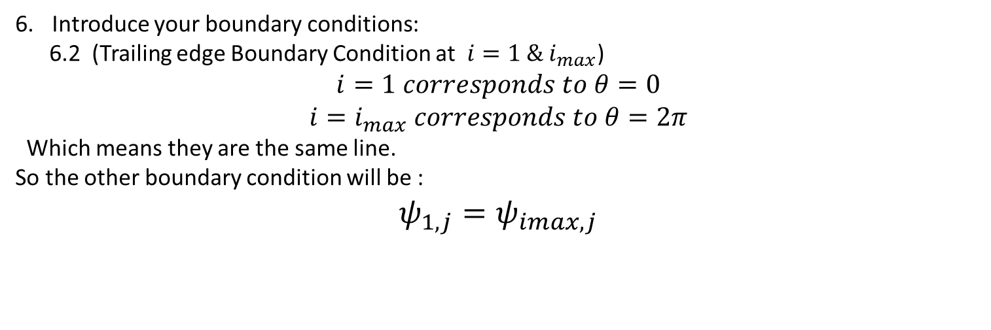
Flow Over an Airfoil Using O-grid
Introduce your boundary conditions:
6.2 (Trailing edge Boundary Condition at $i=1 \& i_{max}$)
$$i=1 corresponds to θ=0$$
$$i=i_{max} corresponds to θ=2π$$
Which means they are the same line.
So the other boundary condition will be :
$$ψ_{1,j}=ψ_{imax,j}$$

Slide 5
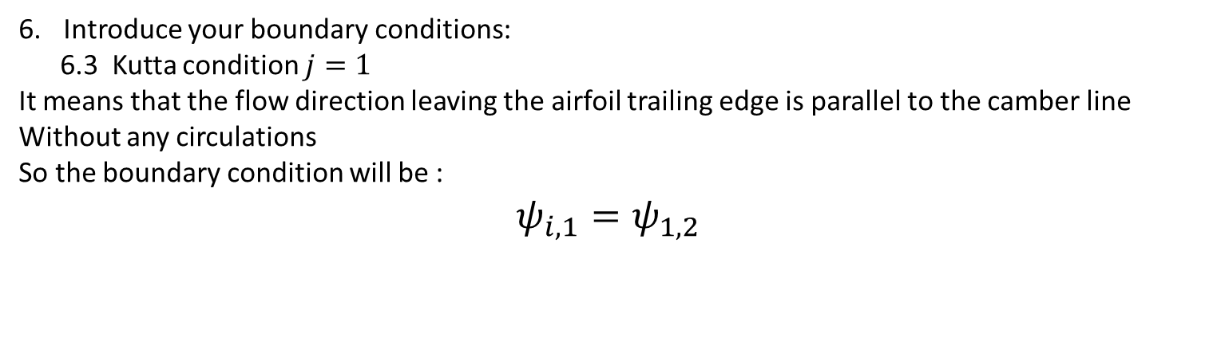
Flow Over an Airfoil Using O-grid
Introduce your boundary conditions:
6.3 Kutta condition $j=1$
It means that the flow direction leaving the airfoil trailing edge is parallel to the camber line
Without any circulations
So the boundary condition will be :
$$ψ_{i,1}=ψ_{1,2}$$

Slide 6
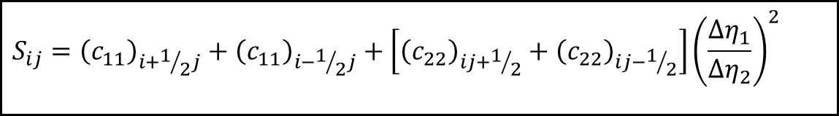
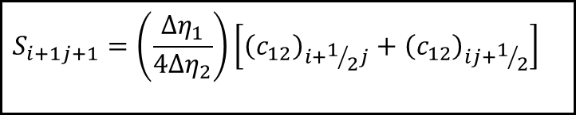
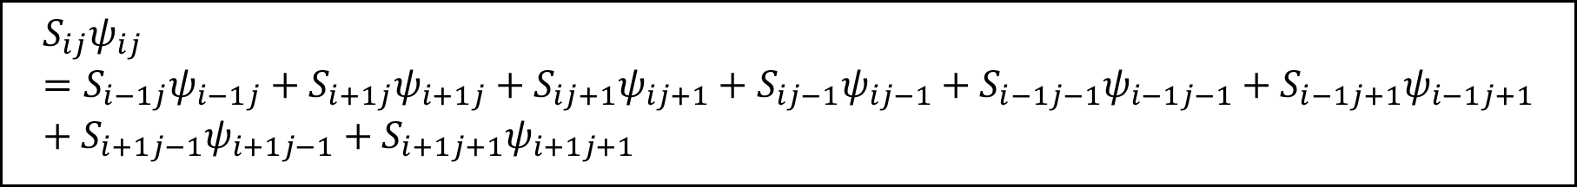
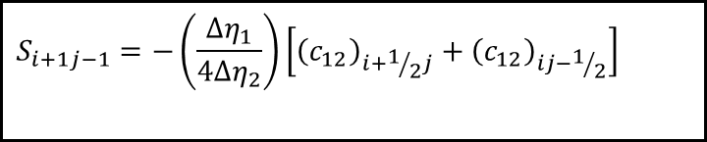
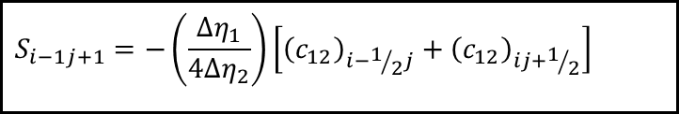
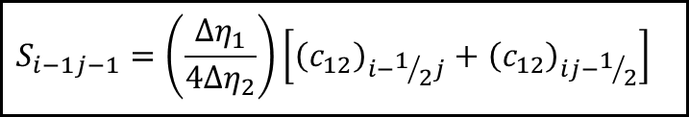
Flow Over an Airfoil Using O-grid
Solution:
The general form of the transformed laplace equation:
$$S_{ij}ψ_{ij}=S_{i−1j}ψ_{i−1j}+S_{i+1j}ψ_{i+1j}+S_{ij+1}ψ_{ij+1}+S_{ij−1}ψ_{ij−1}+S_{i−1j−1}ψ_{i−1j−1}+S_{i−1j+1}ψ_{i−1j+1}+S_{i+1j−1}ψ_{i+1j−1}+S_{i+1j+1}ψ_{i+1j+1}$$
$$S_{ij}={\left(c_{11}\right)}_{i+1/2j}+{\left(c_{11}\right)}_{i−1/2j}+\left[{\left(c_{22}\right)}_{ij+1/2}+{\left(c_{22}\right)}_{ij−1/2}\right]{\left(\frac{Δη_{1}}{Δη_{2}}\right)}^{2}$$
$$S_{i−1j−1}=\left(\frac{Δη_{1}}{4Δη_{2}}\right)\left[{\left(c_{12}\right)}_{i−1/2j}+{\left(c_{12}\right)}_{ij−1/2}\right]$$
$$S_{i−1j+1}=−\left(\frac{Δη_{1}}{4Δη_{2}}\right)\left[{\left(c_{12}\right)}_{i−1/2j}+{\left(c_{12}\right)}_{ij+1/2}\right]$$
$$S_{i+1j−1}=−\left(\frac{Δη_{1}}{4Δη_{2}}\right)\left[{\left(c_{12}\right)}_{i+1/2j}+{\left(c_{12}\right)}_{ij−1/2}\right]$$
$$S_{i+1j+1}=\left(\frac{Δη_{1}}{4Δη_{2}}\right)\left[{\left(c_{12}\right)}_{i+1/2j}+{\left(c_{12}\right)}_{ij+1/2}\right]$$

Slide 7
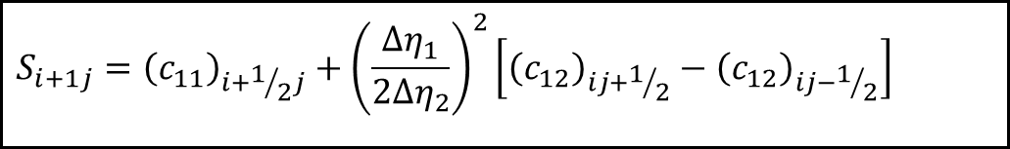
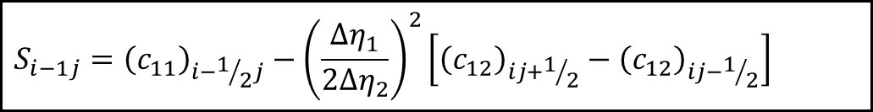
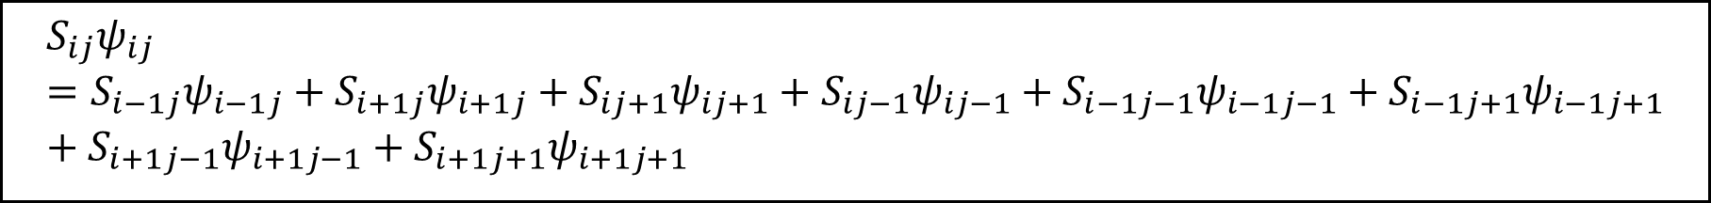
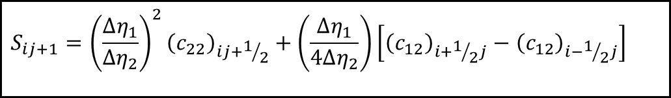
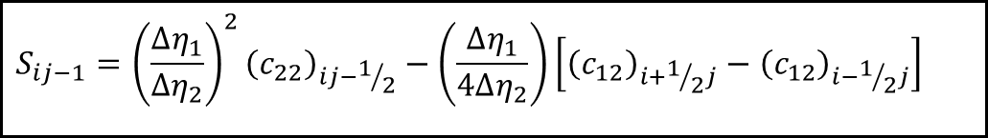
Flow Over an Airfoil Using O-grid
$$S_{ij}ψ_{ij}=S_{i−1j}ψ_{i−1j}+S_{i+1j}ψ_{i+1j}+S_{ij+1}ψ_{ij+1}+S_{ij−1}ψ_{ij−1}+S_{i−1j−1}ψ_{i−1j−1}+S_{i−1j+1}ψ_{i−1j+1}+S_{i+1j−1}ψ_{i+1j−1}+S_{i+1j+1}ψ_{i+1j+1}$$
$$S_{i−1j}={\left(c_{11}\right)}_{i−1/2j}−{\left(\frac{Δη_{1}}{2Δη_{2}}\right)}^{2}\left[{\left(c_{12}\right)}_{ij+1/2}−{\left(c_{12}\right)}_{ij−1/2}\right]$$
$$S_{i+1j}={\left(c_{11}\right)}_{i+1/2j}+{\left(\frac{Δη_{1}}{2Δη_{2}}\right)}^{2}\left[{\left(c_{12}\right)}_{ij+1/2}−{\left(c_{12}\right)}_{ij−1/2}\right]$$
$$S_{ij−1}={\left(\frac{Δη_{1}}{Δη_{2}}\right)}^{2}{\left(c_{22}\right)}_{ij−1/2}−\left(\frac{Δη_{1}}{4Δη_{2}}\right)\left[{\left(c_{12}\right)}_{i+1/2j}−{\left(c_{12}\right)}_{i−1/2j}\right]$$
$$S_{ij+1}={\left(\frac{Δη_{1}}{Δη_{2}}\right)}^{2}{\left(c_{22}\right)}_{ij+1/2}+\left(\frac{Δη_{1}}{4Δη_{2}}\right)\left[{\left(c_{12}\right)}_{i+1/2j}−{\left(c_{12}\right)}_{i−1/2j}\right]$$

Slide 8
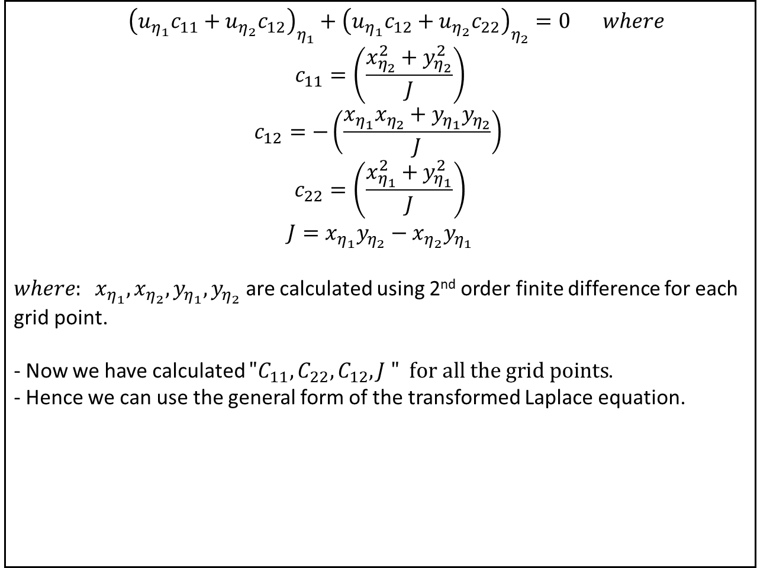
Flow Over an Airfoil Using O-grid
$$\begin{matrix} & \end{matrix}{\left(u_{η_{1}}c_{11}+u_{η_{2}}c_{12}\right)}_{η_{1}}+{\left(u_{η_{1}}c_{12}+u_{η_{2}}c_{22}\right)}_{η_{2}}=0\begin{matrix} & \end{matrix}where \\ c_{11}=\left(\frac{x_{η_{2}}^{2}+y_{η_{2}}^{2}}{J}\right)$$
$$\begin{matrix} \\ \end{matrix}c_{12}=−\left(\frac{x_{η_{1}}x_{η_{2}}+y_{η_{1}}y_{η_{2}}}{J}\right)\begin{matrix} \\ \end{matrix}$$
$$c_{22}=\left(\frac{x_{η_{1}}^{2}+y_{η_{1}}^{2}}{J}\right)$$
$$J=x_{η_{1}}y_{η_{2}}−x_{η_{2}}y_{η_{1}}$$
$where: x_{η_{1}}, x_{η_{2}},y_{η_{1}},y_{η_{2}}$ are calculated using 2nd order finite difference for each grid point.
- Now we have calculated ${"C}_{11},C_{22},C_{12},J " for all the grid points$.
- Hence we can use the general form of the transformed Laplace equation.

Slide 9
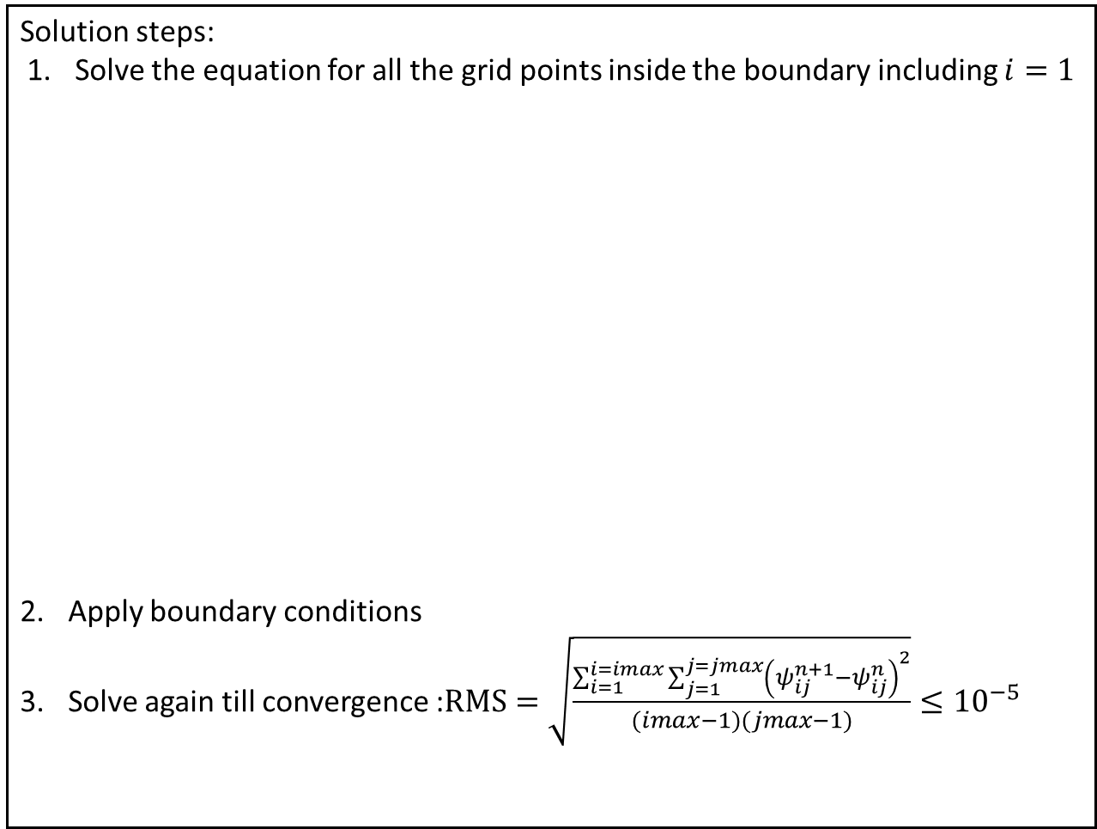
Flow Over an Airfoil Using O-grid
Solution steps:
Solve the equation for all the grid points inside the boundary including $i=1$
Apply boundary conditions
Solve again till convergence :$RMS=\sqrt{\frac{\sum_{i=1}^{i=imax}{\sum_{j=1}^{j=jmax}{{\left(ψ_{ij}^{n+1}−ψ_{ij}^{n}\right)}^{2}}}}{(imax−1)(jmax−1)}}≤{10}^{−5}$

Slide 10
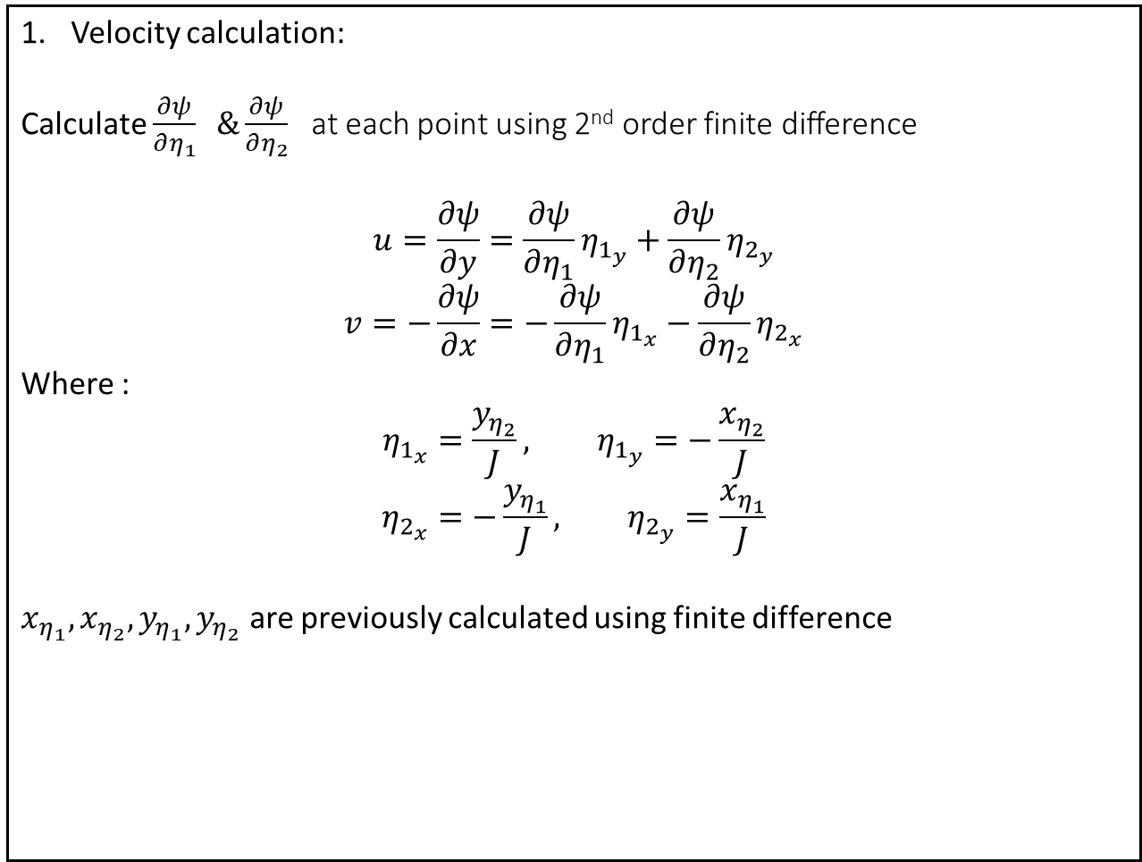
Flow Over an Airfoil Using O-grid
Velocity calculation:
Calculate $\frac{∂ψ}{∂η_{1}} \&\frac{∂ψ}{∂η_{2}}$at each point using 2nd order finite difference
$$u=\frac{∂ψ}{∂y}=\frac{∂ψ}{∂η_{1}}η_{1_{y}}+\frac{∂ψ}{∂η_{2}}η_{2_{y}}$$
$$v=−\frac{∂ψ}{∂x}=−\frac{∂ψ}{∂η_{1}}η_{1_{x}}−\frac{∂ψ}{∂η_{2}}η_{2_{x}}$$
Where :
$$η_{1_{x}}=\frac{y_{η_{2}}}{J}, η_{1_{y}}=−\frac{x_{η_{2}}}{J}$$
$$η_{2_{x}}=−\frac{y_{η_{1}}}{J}, η_{2_{y}}=\frac{x_{η_{1}}}{J}$$
$x_{η_{1}}, x_{η_{2}},y_{η_{1}},y_{η_{2}}$ are previously calculated using finite difference

Slide 11

Flow Over an Airfoil Using O-grid
2. Pressure calculation
$$P=P_{∞}+\frac{1}{2}ρ\left(V_{∞}^{2}−V^{2}\right)$$
$$C_{p}=\frac{{P−P}_{∞}}{\frac{1}{2}ρV_{∞}^{2}}=1−{\left(\frac{V}{V_{∞}}\right)}^{2}$$

Slide 12
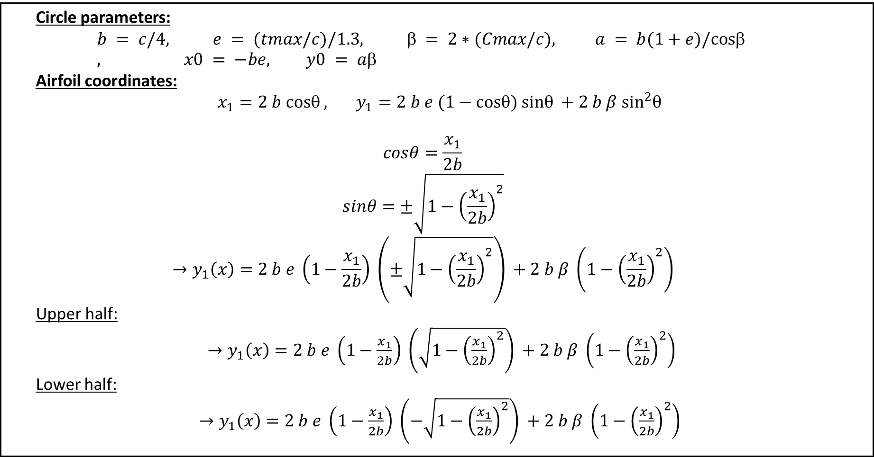
Joukowski
Circle parameters:
$$b = c/4, e = (tmax/c)/1.3,  = 2∗(Cmax/c), a = b(1+e)/cos , x0 = −be, y0 = a$$
Airfoil coordinates:
$x_{1}=2 b cosθ , y_{1}=2 b e (1−cosθ) sinθ +2 b β \sin^{2}θ$
$$cosθ=\frac{x_{1}}{2b}$$
$$sinθ=±\sqrt{1−{\left(\frac{x_{1}}{2b}\right)}^{2}}$$
$$→y_{1}\left(x\right)=2 b e \left(1−\frac{x_{1}}{2b}\right) \left(±\sqrt{1−{\left(\frac{x_{1}}{2b}\right)}^{2}}\right) +2 b β \left(1−{\left(\frac{x_{1}}{2b}\right)}^{2}\right)$$
Upper half:
$→y_{1}\left(x\right)=2 b e \left(1−\frac{x_{1}}{2b}\right) \left(\sqrt{1−{\left(\frac{x_{1}}{2b}\right)}^{2}}\right) +2 b β \left(1−{\left(\frac{x_{1}}{2b}\right)}^{2}\right)$
Lower half:
$→y_{1}\left(x\right)=2 b e \left(1−\frac{x_{1}}{2b}\right) \left(−\sqrt{1−{\left(\frac{x_{1}}{2b}\right)}^{2}}\right) +2 b β \left(1−{\left(\frac{x_{1}}{2b}\right)}^{2}\right)$

